Slide 1
CS143: Disk
Professor Junghoo “John” Cho

Slide 2
System Architecture
CPU
System Bus
Disk Controller
...
Word
(1B – 64B)
~ 10 GB/sec
Block
(512B – 50KB)
~ 100 MB/sec
Disk
Main Memory

Slide 3
Magnetic disk vs SSD
Magnetic Disk
Stores data on a magnetic disk
Typical capacity: 1TB – 10TB
Solid State Drive (SSD)
Stores data in NAND flash memory
Typical capacity: 100GB – 1TB
Faster and more reliable than magnetic disk
But, x10 more expensive and limited write cycles (~2000)

Slide 4
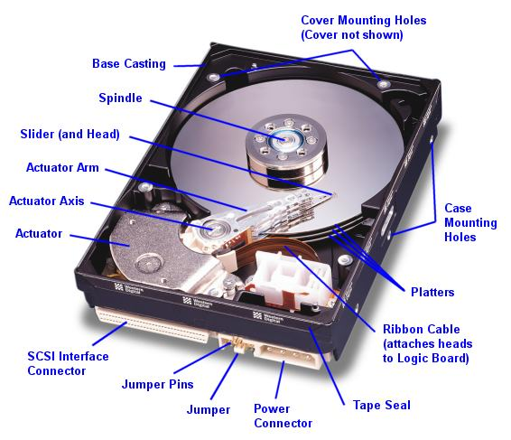

Slide 5
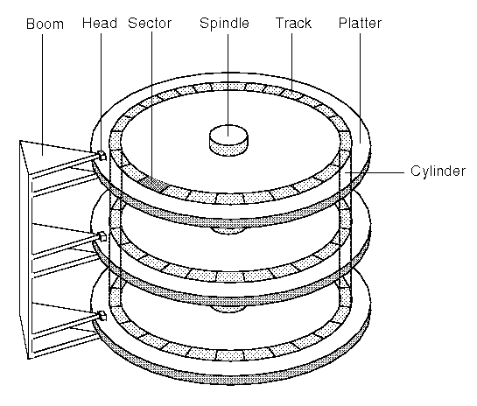

Slide 6
Structure of a Platter
Track, cylinder, sector (=block, page)

Slide 7
Typical Magnetic Disk
Platter diameter: 2.5-5.25 in
Platters: 1 – 20
Tracks: 1000 – 50,000
Sectors per track: 1000 – 50,000
Sector size: 512 – 50K
Rotation speed: 1000 – 15000 rpm
Overall capacity: 1TB – 10TB
Q: 2 platters, 2 surfaces/platter, 20,000 tracks/surface, 20,000 sectors/track, 1KB/sector. What is the overall capacity?

Slide 8
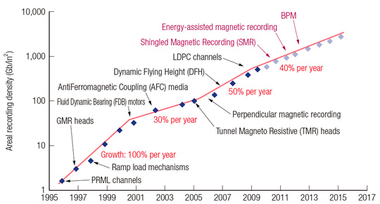
Capacity of Magnetic Disk
- Capacity keeps increasing, but what about speed?

Slide 9
Access Time
CPU
Disk
Q: How long does it take to read a page of a disk to memory?
Q: What needs to be done to read a page?
page
Memory

Slide 10
Reading a Page From Disk
Q: What should happen to read the highlighted sector from disk?
Disk arm

Slide 11
Reading a Page From Disk
Q: What should happen to read the highlighted sector from disk?
Disk arm

Slide 12
Reading a Page From Disk
Q: What should happen to read the highlighted sector from disk?
Disk arm

Slide 13
Reading a Page From Disk
Q: What should happen to read the highlighted sector from disk?
Disk arm

Slide 14
Access Time
Access time = (seek time) + (rotational delay) + (transfer time)

Slide 15
Seek Time
Time to move a disk head between tracks
Track to track ~ 1ms
Average ~ 10 ms
Full stroke ~ 20 ms
5 - 20x
Time
x
1
N
Cylinders Traveled

Slide 16
Rotational Delay
Typical disk:
1000 rpm – 15000 rpm
Q: For 6000 RPM, average rotational delay?
Head Here
Block I Want

Slide 17
Transfer Time
Read blocks as
the platter rotates
6000RPM 10,000 sectors/track
Q: How long to read one sector?
Disk Head

Slide 18
Access Time
6000RPM, 10,000 sectors/track
Average access time to read one sector = (seek time) + (rotational delay) + (transfer time)

Slide 19
Transfer Rate
The rate at which we can transfer data from disk
Measured in bytes/sec
Q: 6,000 RPM, 10000 sectors/track, 1KB/sector what is the transfer rate?
Burst transfer rate vs Sustained transfer rate
(Burst) Transfer rate = (RPM / 60) * (sectors/track) * (bytes/sector)

Slide 20
Sequential vs. Random I/O
Q: How long to read 3 sequential sectors?
6000 RPM
10,000 sectors/track
Assume the head is above the first sector

Slide 21
Sequential vs. Random I/O
Q: How long to read 3 random sectors?
6000 RPM
10,000 sectors/track
10ms seek time
Assume the head is above the first sector

Slide 22
Random I/O
For magnetic disks:
Random I/O is VERY expensive compared to sequential I/O
Avoid random I/O as much as we can

Slide 23
Magnetic Disk vs SSD
 | Magnetic | SSD
Random IO | ~100 IOs/sec | ~100K IOs/sec
Transfer rate | ~ 100MB/sec | ~500MB/sec
Capacity/$ | ~1TB/$30 (in 2016) | ~100GB/$30 (in 2016)
SSD speed gain is mainly from high random IO rate

Slide 24
Data Modification
Byte-level modification not allowed
Can be modified by blocks
Q: How can we modify only a part of a block?

Slide 25
Buffers, Buffer pool
Temporary main-memory “cache” for disk blocks
Avoid future read
Hide disk latency
Most DBMS let users change buffer pool size

Slide 26
Abstraction by OS
1
Sequential blocks
No need to worry about head, cylinder, sector
Access to non-adjacent blocks
Random I/O
Access to adjacent blocks
Sequential I/O
2
3
4
.
.
.
(head, cylinder, sector)

Slide 27
Reference
Storage review disk guide
http://www.storagereview.com/guide2000/ref/hdd/index.html

Slide 28
CS143: Files
Professor Junghoo “John” Cho

Slide 29
Files: Main Problem
How to store tables into disks?
Q: 512Byte block. 80Byte tuple. How to store?
Jane | CS | 3.7
Susan | ME | 1.8
June | EE | 2.6
Tony | CS | 3.1

Slide 30
Spanned vs Unspanned
Unspanned
Spanned
Q: Maximum space waste for unspanned?
T1
T4
T2
T5
T3
T6
T1
T4
T5
T2
T6
T3
T4
T7
T8

Slide 31
Variable-Length Tuples
How do we store them?
T1
T2
T3
T4

Slide 32
Reserved Space
Reserve the maximum space for each tuple
Q: Any problem?
T1
T2
T3
T4
T5
T6

Slide 33
Variable-Length Space
Pack tuples tightly
Q: How do we know the end of a tuple?
Q: What to do for delete/update?
Q: How can we “point to” to a tuple?
R1
R2
R3
R4 R5
R6

Slide 34
Slotted Page
Header
R3
Block
Free space
R4
R1 R2
Q: How can we point to a tuple?

Slide 35
Long Tuples
ProductReview( pid INT, reviewer VARCHAR(50), date DATE, rating INT, comments VARCHAR(1000))
Block size 512B
How should we store it?

Slide 36
Long Tuples
Spanning
Splitting tuples
Block with short attributes.
Block with long attrs.
T1 (a)
T1 (b)
T2 (a)
T2 (b)
T2 (b)
This block may also have fixed-length slots.

Slide 37
Sequential File
Tuples are ordered by certain attribute(s) (search key)
Search key: Name
Elaine
CS
3.7
James
ME
2.8
John
EE
1.8
Peter
EE
3.9
Susan
CS
1.0
Tony
EE
2.4

Slide 38
Sequencing Tuples
Inserting a new tuple
Easy case
T1
T3
T6
T8
?
T7

Slide 39
Two Options
1) Rearrange
2) Linked list
T1
T1
T3
T7
T6
T3
T7
T6
T8
T8

Slide 40
Sequencing Tuples
Inserting a new tuple
Difficult case
T1
T4
T5
T8
T9
?
T7

Slide 41
Sequencing Tuples
Overflow page
Reserving free space to avoid overflow
PCTFREE in DBMS
CREATE TABLE R(a int) PCTFREE 40
header
Overflow page
T1
T8
T2
T9
T4
T6
T7

Slide 42
Things to Remember
Disk
Platter, track, cylinder, block (sector)
Seek time, rotational delay, transfer time
Random I/O vs Sequential I/O
Files
Spanned/unspanned tuples
Variable-length tuples (slotted page)
Long tuples
Sequential file and search key
Problems with insertion (overflow page)
PCTFREE

